Slide 1

Notes:
Source: Oxford International Primary Computing Student Book 5, Unit 2, section 2.3 Search results, printed pages 26–27, and section 2.4 Choosing web content, pages 28–29. Classroom adaptation. Generated visuals are illustrative examples. Search ranking varies and meta tags do not guarantee high ranking.

Slide 2

Notes:
Source: Oxford International Primary Computing Student Book 5, Unit 2, section 2.3 Search results, printed pages 26–27, and section 2.4 Choosing web content, pages 28–29. Classroom adaptation. Generated visuals are illustrative examples. Search ranking varies and meta tags do not guarantee high ranking.

Slide 3

Notes:
Source: Oxford International Primary Computing Student Book 5, Unit 2, section 2.3 Search results, printed pages 26–27, and section 2.4 Choosing web content, pages 28–29. Classroom adaptation. Generated visuals are illustrative examples. Search ranking varies and meta tags do not guarantee high ranking.

Slide 4

Notes:
Source: Oxford International Primary Computing Student Book 5, Unit 2, section 2.3 Search results, printed pages 26–27, and section 2.4 Choosing web content, pages 28–29. Classroom adaptation. Generated visuals are illustrative examples. Search ranking varies and meta tags do not guarantee high ranking.

Slide 5
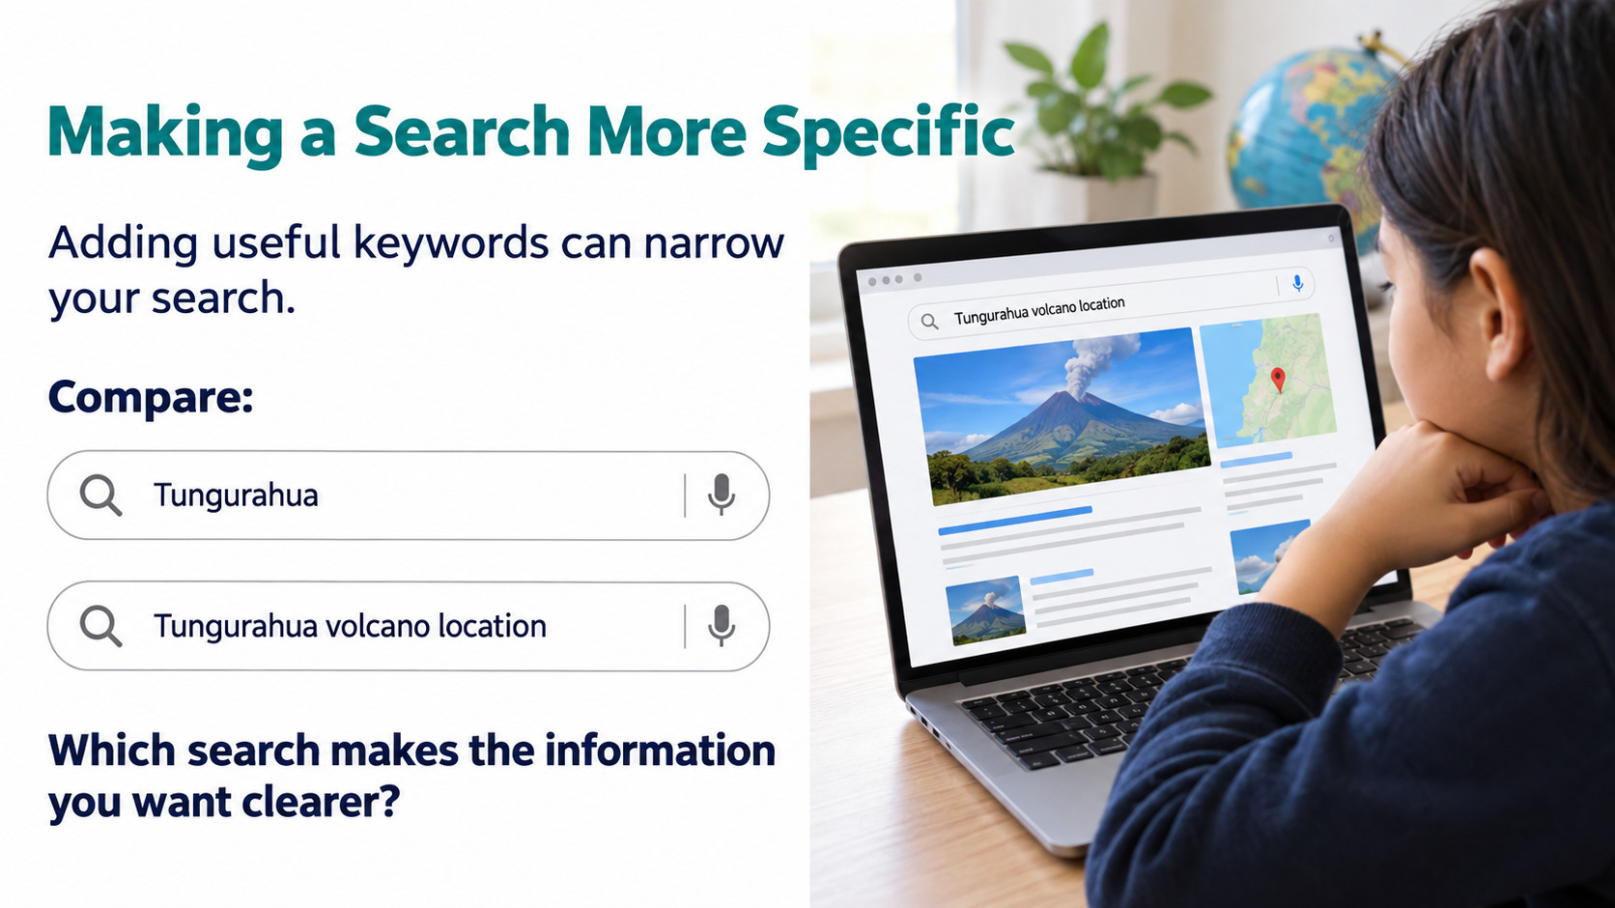
Notes:
Source: Oxford International Primary Computing Student Book 5, Unit 2, section 2.3 Search results, printed pages 26–27, and section 2.4 Choosing web content, pages 28–29. Classroom adaptation. Generated visuals are illustrative examples. Search ranking varies and meta tags do not guarantee high ranking.

Slide 6

Notes:
Source: Oxford International Primary Computing Student Book 5, Unit 2, section 2.3 Search results, printed pages 26–27, and section 2.4 Choosing web content, pages 28–29. Classroom adaptation. Generated visuals are illustrative examples. Search ranking varies and meta tags do not guarantee high ranking.

Slide 7

Notes:
Source: Oxford International Primary Computing Student Book 5, Unit 2, section 2.3 Search results, printed pages 26–27, and section 2.4 Choosing web content, pages 28–29. Classroom adaptation. Generated visuals are illustrative examples. Search ranking varies and meta tags do not guarantee high ranking.

Slide 8

Notes:
Source: Oxford International Primary Computing Student Book 5, Unit 2, section 2.3 Search results, printed pages 26–27, and section 2.4 Choosing web content, pages 28–29. Classroom adaptation. Generated visuals are illustrative examples. Search ranking varies and meta tags do not guarantee high ranking.

Slide 9

Notes:
Source: Oxford International Primary Computing Student Book 5, Unit 2, section 2.3 Search results, printed pages 26–27, and section 2.4 Choosing web content, pages 28–29. Classroom adaptation. Generated visuals are illustrative examples. Search ranking varies and meta tags do not guarantee high ranking.

Slide 10
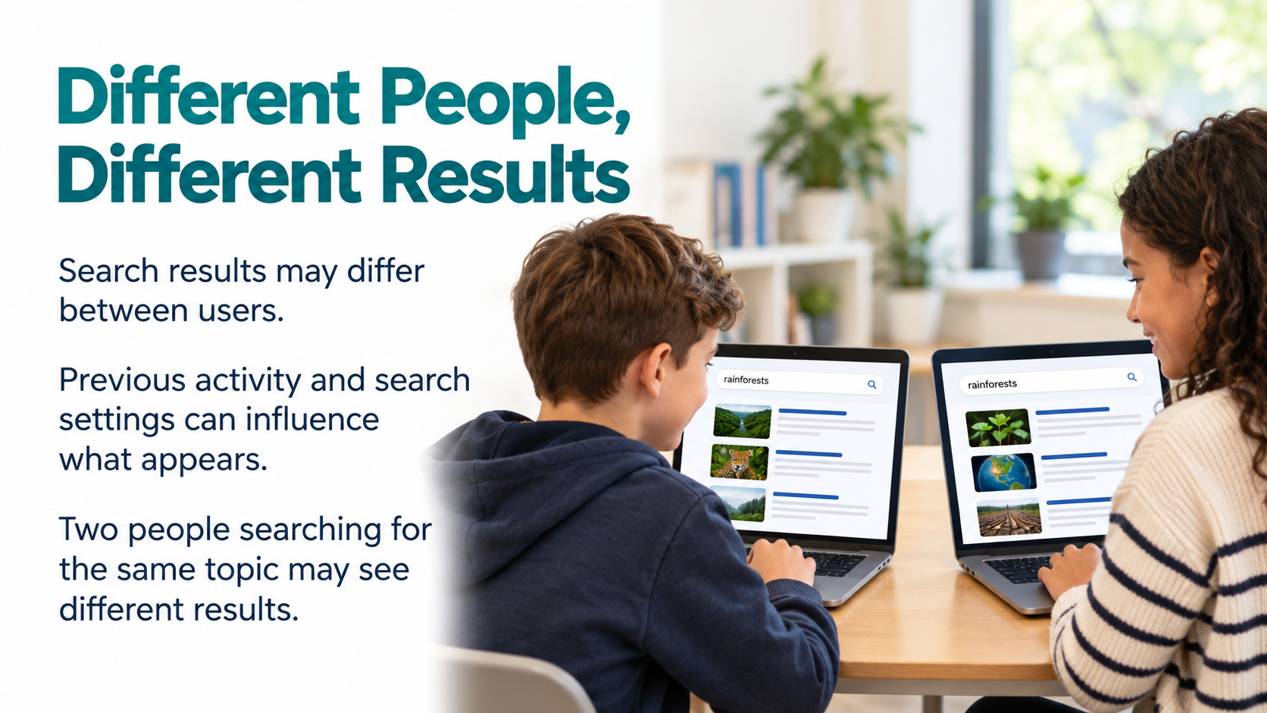
Notes:
Source: Oxford International Primary Computing Student Book 5, Unit 2, section 2.3 Search results, printed pages 26–27, and section 2.4 Choosing web content, pages 28–29. Classroom adaptation. Generated visuals are illustrative examples. Search ranking varies and meta tags do not guarantee high ranking.

Slide 11

Notes:
Source: Oxford International Primary Computing Student Book 5, Unit 2, section 2.3 Search results, printed pages 26–27, and section 2.4 Choosing web content, pages 28–29. Classroom adaptation. Generated visuals are illustrative examples. Search ranking varies and meta tags do not guarantee high ranking.

Slide 12

Notes:
Source: Oxford International Primary Computing Student Book 5, Unit 2, section 2.3 Search results, printed pages 26–27, and section 2.4 Choosing web content, pages 28–29. Classroom adaptation. Generated visuals are illustrative examples. Search ranking varies and meta tags do not guarantee high ranking.

Slide 13

Notes:
Source: Oxford International Primary Computing Student Book 5, Unit 2, section 2.3 Search results, printed pages 26–27, and section 2.4 Choosing web content, pages 28–29. Classroom adaptation. Generated visuals are illustrative examples. Search ranking varies and meta tags do not guarantee high ranking.

Slide 14

Notes:
Source: Oxford International Primary Computing Student Book 5, Unit 2, section 2.3 Search results, printed pages 26–27, and section 2.4 Choosing web content, pages 28–29. Classroom adaptation. Generated visuals are illustrative examples. Search ranking varies and meta tags do not guarantee high ranking.

Slide 15

Notes:
Source: Oxford International Primary Computing Student Book 5, Unit 2, section 2.3 Search results, printed pages 26–27, and section 2.4 Choosing web content, pages 28–29. Classroom adaptation. Generated visuals are illustrative examples. Search ranking varies and meta tags do not guarantee high ranking.

